Slide 1
UE22CS320A – Capstone Project Phase – 1
SEMESTER - V
END SEMESTER ASSESSMENT
Project Title : Generative AI marketing based on sales- anomaly detection
Project ID : PW25_SSS_06
Project Guide :Dr. Shylaja S.S
Project Team : Suhani Verma, Hrishita Patra,
Dhruva R Prasad, Srishti Mathur
Hrishita Patra_Srishti Mathur_Suhani Verma_Dhruva R Prasad

Slide 2

Outline
Introduction
Abstract and Scope
Problem Statement
Literature survey / Background study
Suggestions from Review – 1 and changes incorporated
Suggestions from Review – 2 and changes incorporated
Research / Technology gap and Challenges
Objectives
Further Literature Survey (Extensive)
Dataset exploration (if any)
System Architecture(if any)
References
Any other Information
Hrishita Patra_Srishti Mathur_Suhani Verma_Dhruva R Prasad

Slide 3
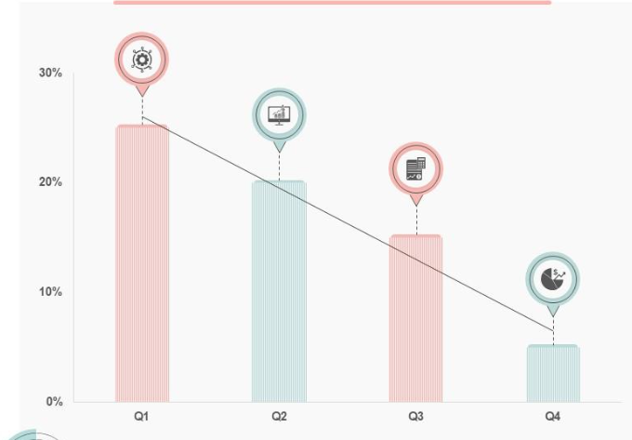
Introduction
Generative AI Marketing by Sales Anomaly Detection innovatively combines techniques of machine learning with strategic business intelligence.
What could these anomalies indicate?
Ineffective Sales Strategies
Current Trends
Hrishita Patra_Srishti Mathur_Suhani Verma_Dhruva R Prasad

Slide 4
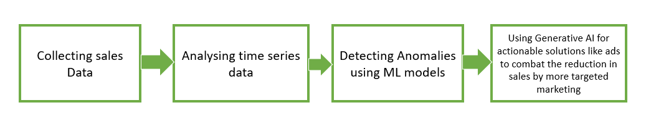
Problem Statement
What our project aims to do:
Hrishita Patra_Srishti Mathur_Suhani Verma_Dhruva R Prasad

Slide 5
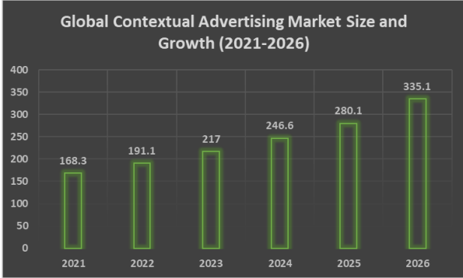
ABSTRACT
Anomaly detection is crucial for understanding patterns that deviate from the norm, especially within sales data, where underperformance may indicate strategic or operational gaps. An unusual dip in sales for a functionally sound product/service could indicate a lack in effective and attractive marketing.
An early detection of such dips through Machine learning and graphical methods ,and correspondingly working on using an effective prompt strategy for a generative AI model to develop suitable ads will provide for an integrated workflow.
Prompts could be used to generate an intermediate stage of contextually relevant text using LLMs which could be integrated with a GAN technology to develop static image advertisements.
Hrishita Patra_Srishti Mathur_Suhani Verma_Dhruva R Prasad

Slide 6
Literature Survey
1)Deep Learning for Anomaly Detection: A Review
Authors: Guansong Pang,Chunhua Shen, Longbing Cao, Anton Van den Hengel
Problem Addressed
Anomaly detection involves identifying data points or sets that deviate significantly from the majority. It has applications in fields like risk management, security, licensing, and healthcare. Deep anomaly detection outperforms traditional methods by learning feature representations and anomaly scores, making it highly effective for complex, high-dimensional, temporal, and spatial data.
Dataset
A collection of real-world dataset containing natural anomalies in different modes and with different types of publicly available methods.

Slide 7
Methodology
Deep anomaly detection required feature extraction through models like autoencoders and GANs, learning representations of normality through self-supervised classification, and end-to-end anomaly scoring techniques like one-class classification. It addresses very important issues, those regarding data representation and scoring optimization.
Results
The results describe 12 deep learning methods for anomaly detection and have provided an explanation of 30 algorithms characteristics such as data augmentation and pre-training. These findings demonstrate a shift in deep anomaly detection that attempts to resolve simple challenges across applications.

Slide 8
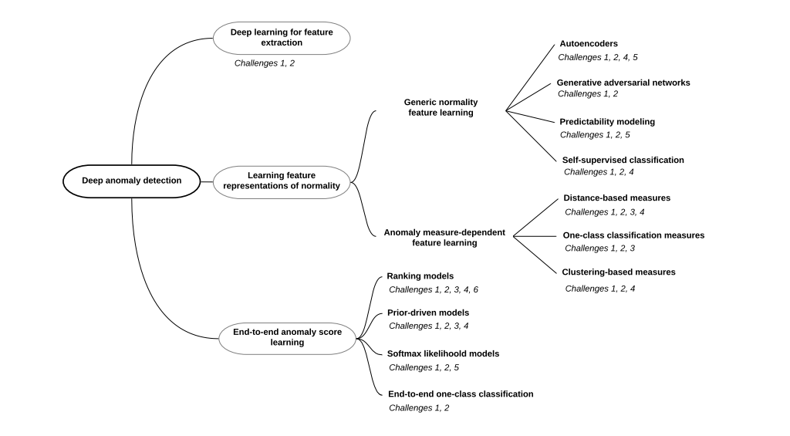
Future works
Future work includes improving robustness to imbalanced and unlabeled data, enhancing model interpretability, developing efficient algorithms for large datasets, and expanding evaluation metrics beyond traditional measures.

Slide 9
2)Optimizing Contextual Advertising With Large Language Models: A Unified Approach
To Ad Content Generation And Targeting.
Authors: Lav Kumar Salesforce Inc., USA ; Karan Khanna Netflix, USA
Date: January-June 2024
Problem Identified:
This paper also encompasses a new approach called Contextual Ad Generation and Targeting (CAGT), which depends on LLMs for generating ad content, while optimizing keyword targeting in one single framework.
Dataset:
The dataset holds about 10 million impressions in ads along with other accompanying user information, content related to ads, relevant target keywords, and various other performance metrics, including, but not limited to CTR and CR.
Methodology:
The CAGT framework consists of three fundamental components:
1) Adaptive Prompt Engineering
2) LLM-based Ad Generation, and
3) Reinforcement Learning-based Feedback Loop

Slide 10
Result:
The results are shown in terms of CTR, CR, and relevance score for all baseline methods and CAGT. For instance, CAGT gains 23% improvement in terms of CTR and 18% in terms of CR compared to the best-performing baseline method, LL based Ad Generation.
Future works:
Future research directions might focus on the integration of multimodal information, for instance images and videos into generating ads. Another domain CAGT could be used in is social media advertising and email marketing. Both areas can be explored in depth and may give some insightful value to take forward this line of work.

Slide 11
3)Generative Artificial Intelligence: A Systematic Review and Applications
Authors: Sandeep Singh Sengar, Affan Bin Hasan, Sanjay Kumar, Fiona Carroll Published: March 2024
Problem Identified
The paper reviews advancements in Generative AI models likeGANs, Transformers, VAEs, and Diffusion Models with an emphasis on their applications and ethical considerations.
Dataset
It uses datasets like ImageNet, CelebA, and MIMIC for images; Kinetics and VoxCeleb for videos; and CoNLL-2003, DUC-2002, and XNLI for NLP, putting an emphasis on ethical use of data.
Methodology
From 2012 to 2023, a systematic review was carried out that utilized standardized metrics like FID (images) and ROUGE (text) to analyze model architectures and applications.

Slide 12
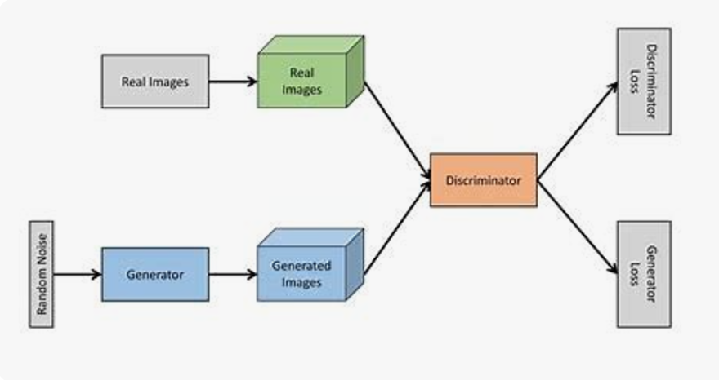
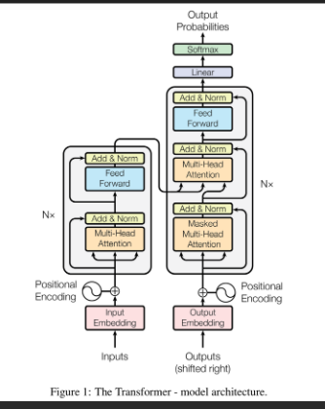
Results
Swin Transformers and UVCGANs were more effective than other models in completing image tasks; MViTv2 achieved 86.1% of video classification. NLP tasks were proficiently carried out by GPT, BERT and ChatGPT, while synthetic data creation was improved by generative models.
Future Scope
In the future, research will concentrate on ethical AI principles and their scaling, as well as cross-modal tasks like combining text to images and domain-specific applications such as education and molecular synthesis.

Slide 13
4)Automated Model Selection For Time Series Anomaly Detection
Authors: Yuanxiang Ying, Juanyong Duan, Chunlei Wang, Yujing Wang, Congrui Huang, Bixiong Xu
Date:2020
Problem identified:
The issue concerns time-series anomaly detection where diverse and noisy data make it possible for training supervised models due to shortage of labels. Automated model selection framework has been proposed to find the models fit for incoming data along with a custom tuning algorithm for filtering anomalies. This is fitting in new detectors, and also meets specific client requirements.
Dataset:
Time-series dataset, TSD, divided into a 3:1 ratio for training and testing. For each anomaly-increasing detector MiM_iMi​, a set of candidate parameters is evaluated, and the best performing pair is used, according to the F1 score, as the ground truth for the model selector and parameter estimator.

Slide 14
Methodology:
The methodology involves feature extraction using transformations, including Spectral Residual and FFT; automatic model selection to classify and select the best anomaly detection model with optimized parameters; and a customized tuning phase to refine the detection results on user-defined criteria.
Results :
This result shows that Auto-Selector will outperform individual anomaly detection models in most cases by effectively selecting suitable models and parameters leading to significant improvements of F1 scores and optimization in performance in various data series.
Future Scope:
Improving the efficiency and accuracy of automated model-selection system, making systems less dependent on labeled data, and developing even more adaptable parameter estimation methodology. All these will lead to the development of a more robust, scalable, and effective time-series anomaly detection system in different industrial setups.

Slide 15
5)Generative Ai In Innovation And Marketing Processes: A Roadmap Of Research
Opportunities
Published in Springer
Authors: Paola Cillo and Gaia Rubera
Date:2024
Problem identified:
What are the research possibilities that come generative AI in the marketing domain.
Dataset:
Feedback and inputs got from the people gen-ai in marketing will affect gathered and analysed.
Methodology:
Surveys conducted with people belonging to the field.Thus a proactive approach leading
to an accurate collection of data ,obtained directly from experts in marketing is obtained.

Slide 16
Results:
Narrows down to few areas of growth and research in the domain like:
What market research can be conducted with GenAI rather than human participants or experts?
How can firms vary LLM parameters to create more persuasive messages? Which LLM parameter is most conducive to different marketing goals?
Future works:
Effective prompt strategy
how firms can balance the advantage of supplementing their proprietary data to fully harness GenAI potential
which firms can benefit the most from fine-tuning as well as which firms should instead exercise caution in doing so.

Slide 17
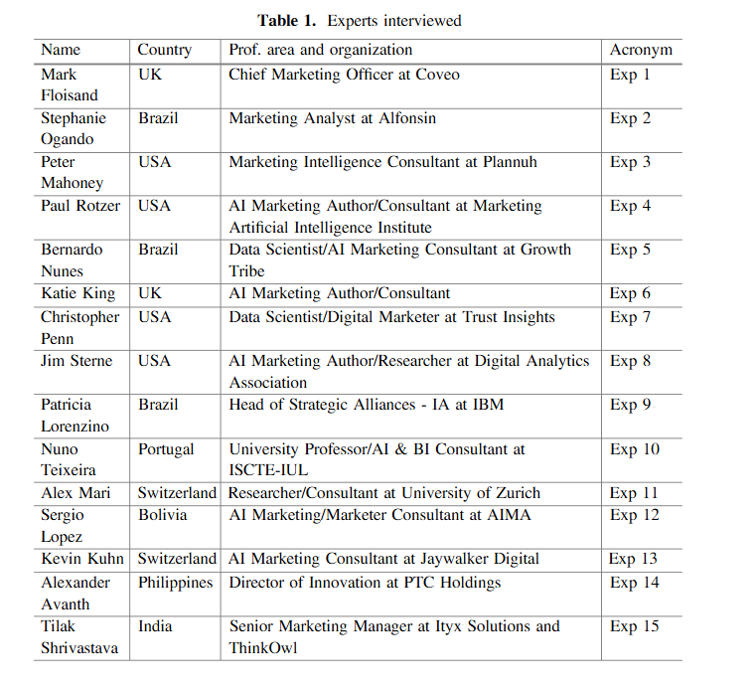
6) Artiﬁcial Intelligence Applied to Digital Marketing
Authors:Tiago Ribeiro and José Luís Reis
Published:June 2020
Problem Addressed
How AI is affecting digital marketing and what are the best ways for companies to use it to improve their marketing strategies
Dataset
As a method of qualitative study, interviews were conducted to collect the primary data necessary to meet the objectives.Table given on the side shows the specialists profile.
Methodology
By analyzing sources and interviewing experts, the study employs a qualitative approach to investigate the advantages of using AI in marketing.

Slide 18
Results
AI in marketing automates tasks,and increases personalization, and improves both speed and accuracy. However, adoption of AI faces major hurdles in terms of data privacy and trust as well as issues with data quality. While the initial setup can be expensive, in the long run AI reduces these operating costs and generates more revenue through better targeting of campaigns.
Future scope
Future work will gather feedback from business managers to better understand AI's impact on marketing and its influence on the lives of target clients.

Slide 19
7) The Role Of Artificial Intelligence In Modern Marketing: A Review Of Current Technologies, Applications, And Challenges Year of Publication : August 2024
Authors : Shardul Marathe
Problem Addressed
Impact of AI in modern marketing, with focus on current technologies, applications and challenges.
Dataset
Articles from 2013 to 2024 were examined using the electronic database Google Scholar, using specific keywords in the searches.
Methodology
Explored only long articles and journals on Google Scholar, filtered only the articles with involvement with the paper's title and abstracts, and narrowed the papers down using some criterion.

Slide 20
Result
It narrows down how AI is transforming modern marketing strategies like:- How AI-driven technologies revolutionize content creation, targeting customers, and pricing strategies?
Considering the advantages, what are the challenges that underscore the necessity of businesses to adopt AI with caution, practicing ethics and robust data management?
Future works
How the transition from traditional marketing to AI-based marketing will happen from an economic, societal, and political point of view.
Analyzing fully AI-based companies versus traditional companies and seeing every metric from click rates to customer retention.
Internal Biases and how AI will deal with it; what policies can manifest in response to copyright and ethical concerns.

Slide 21
Suggestions from Review – 1 and changes incorporated
We were advised to conduct additional research on the technical aspects of Generative AI and sales anomaly detection.
In response, we reviewed key papers, including “Generative Artificial Intelligence: A Systematic Review and Applications” and “Automated Model Selection for Time Series Anomaly Detection.”
These papers provided insights into leveraging LLMs for ad content creation, using advanced anomaly detection techniques, and integrating GenAI for targeted marketing.
The findings were incorporated into our project, enhancing its technical foundation and preparing for a more effective implementation in the next phases.

Slide 22
Suggestions from Review – 2 and changes incorporated
We were advised to review the availability of datasets for the project to ensure suitability and relevance.
In response, we explored various sources and identified some valuable datasets on Kaggle that align with our project objectives.
We are continuing our efforts to find even better datasets by reaching out to companies and exploring industry-specific data sources.

Slide 23
Research/technology gaps
A link between how to connect sales dips to enhancing product marketing through advertisement is a bridge that has not been researched on a lot.
As two separate frameworks ,anomaly detection and gen-ai have been discussed often,but a potential problem-solution approach to the same is what can undergo more research.
Contextual based advertising using LLMs is a commonly used approach for ad text content generation .However using those to integrate with GAN models for static image based advertisements in not widely explored.
Seamless integration into the existing marketing setup.
Improving model interpretability for anomaly detection and model adaptation across the various product categories remains a challenge. More research is needed on how to better deal with unlabeled and unbalanced datasets and how to expand the evaluation metrics used beyond performance indicators such as the F1 score.

Slide 24
OBJECTIVES
The primary identified objectives of the project are as follows:
Analyse authentic sales data of the companies identified in the obtained dataset.
Use graphical as well as machine learning based approaches to identify anomalies in the data.
Understand the marketing requirements and building of a prompt driven gen-ai based image advertisement generator for the product suitable for increasing its reach.
This could help combat the anomaly in the sales for the product.
Refining of the model based on obtained performance parameters to suit the model better to the needs.

Slide 25
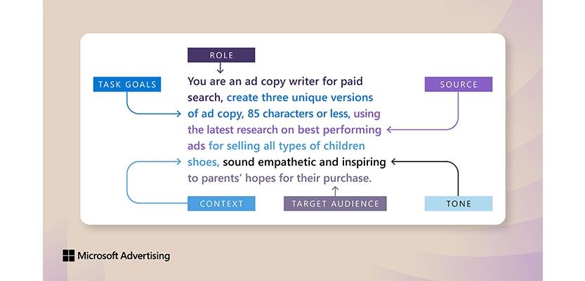
Effective prompt input

Slide 26
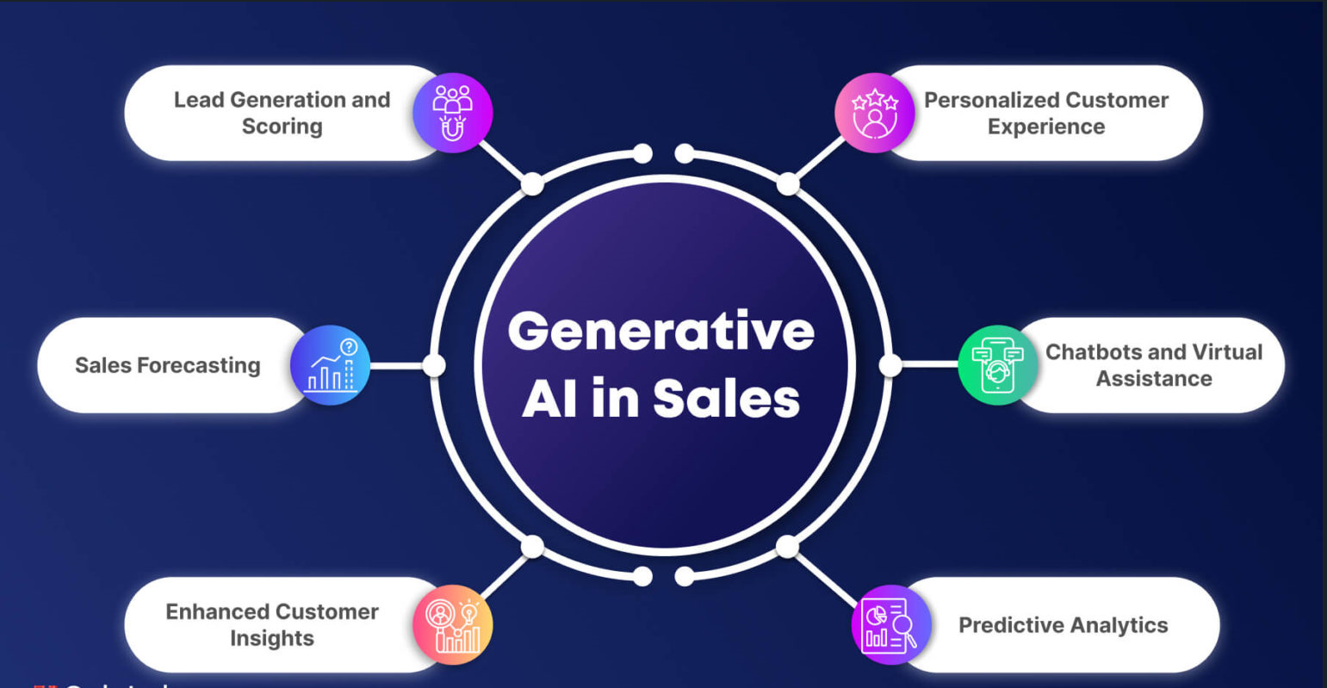

Slide 27
DATASET EXPLORATION
The project utilizes sales data to provide actionable insights for businesses, focusing on targeted marketing strategies and optimization. Time series analysis will detect patterns, trends, and anomalies signaling issues like performance drops or external market forces. GenAI will enhance personalized advertisements to improve sales. Data exploration, including EDA, uncovers trends and relationships, with the Amazon product dataset analyzed for consumer behavior and sales anomalies. Additional datasets will explore seasonal trends, popular products, and event impacts on sales.
The Amazon Product Dataset contains over 1000 ratings and reviews, offering insights into product characteristics and customer responses. Key features include product details (ID, name, category, prices, discounts), customer reviews (rating, content, sentiment), and links to products. This dataset has been obtained from kaggle.

Slide 28
DATASET EXPLORATION
The dataset helps identify anomalies such as:
Rating Anomalies: Sudden rating spikes or drops indicating quality issues or gaming.
Review Anomalies: Surges or declines in review counts due to promotions or fake reviews.
Pricing Anomalies: Irregular price changes or unusual discounts.
Sentiment Anomalies: Unusual sentiment trends misaligned with product ratings.

Slide 29
References/Bibliography
[1]https://www.researchgate.net/publication/341994540_Artificial_Intelligence_Applied_to_Digital_Marketing/
[2]Generative artificial intelligence: a systematic review and applications | Multimedia Tools and Applications
[3] https://link.springer.com/article/10.1007/s11747-024-01044-7
[4] https://arxiv.org/pdf/2009.04395
[5]https://www.researchgate.net/publication/382876702_The_Role_of_Artificial_Intelligence_in_Modern_Marketing_A_Review_of_Current_Technologies_Applications_and_Challenges
[5] https://www.sciencedirect.com/science/article/abs/pii/S0148296323004836
[7] https://arxiv.org/pdf/2007.02500

Slide 30
Thank You

